Slide 1
NBA Career Length
Report 1: Exploratory Data Analysis
Group 4: Ian Rand, Jiale Zhao, Yifan Liu, Sean Cancino
10/15/2020

Slide 2
Introduction
We wished to determine the factors that contributed most to a lengthy career(measured in seasons) for the average player in the NBA

Slide 3
Member Responsibility
Sean: Concept and dataset selection: created initial model without covariates.
Jay: Tackled the raw data to create visuals and did the covariate analysis for the final model
Yifan: Choose the covariates based on Jay’s models and tested for covariate interaction
Ian: Created the powerpoint itself and handled most of the model interpretation

Slide 4
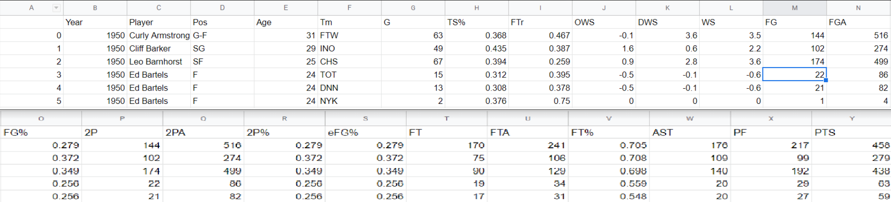
Data Selection
Taken from https://www.kaggle.com/drgilermo/nba-players-stats
We combined three datasets(players and seasons) to get information on player’s career lengths among other factors
53 to 26 vars
deleted 67 obs (24691-24624)

Slide 5
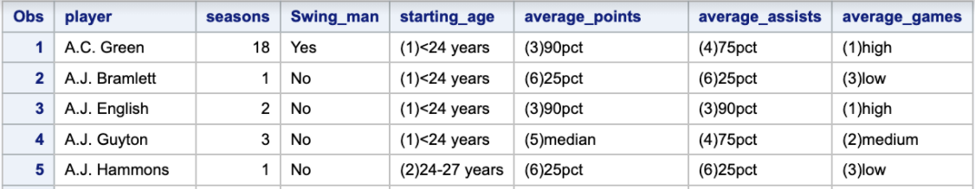
Data Selection: Covariates
Swingman: Whether or not the player played multiple positions
Average number of games played
Total Points scored
Player age when entering the league
Percentage of assists made
The edited dataset

Slide 6

Methods Section
Survival Experience: Survival Analysis measures two key variables: the time(t), leading up to a certain event(d). In our study, the time is measured in seasons, and the event is the player leaving the league.
Kaplan-Meier: The KM curve measures events over time and approximates the Survival rate as
Where n is the number of subjects remaining at that point.
Median: earliest time where 50% or less remain

Slide 7
Methods Section(cont.)
Product-Limit: The PL method approximates the cumulative rate of hazard(event d) at any given point as:
H(t) = -Ln[S(t)]
In our case, it shows the rate of players exiting the NBA
Kernel-Smoothed Estimators: We approximated the hazard rate in intervals by scaling the recorded values using kernel values and creating continuous functions

Slide 8

Methods Section(cont.)
Non-parametric tests: We will employ several non-parametric tests to discern if survival time differs based on covariates.
The tests will be fitted with different weight functions to test how much the subgroups vary at different points in time

Slide 9
Overall Distribution of Survival time
We first modeled the data without considering covariates to understand the overall behavior of the data

Slide 10
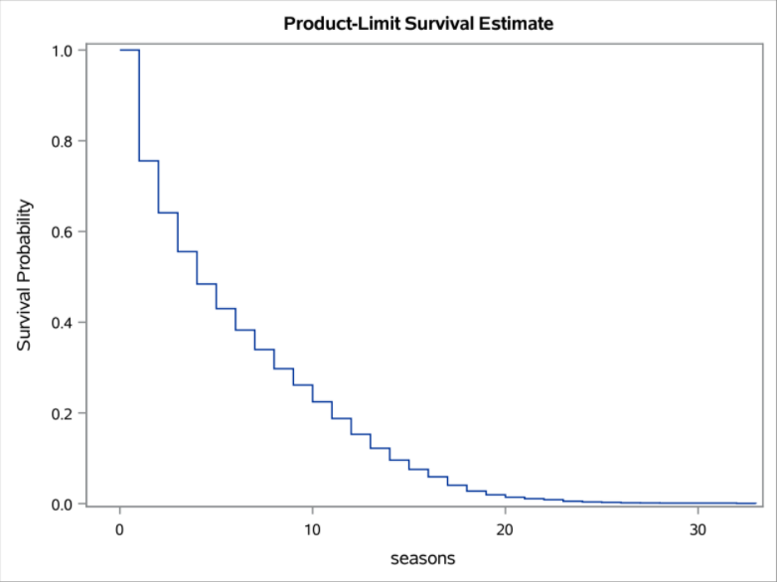
Overall Distribution: Kaplan-Meier Curve
All player’s careers had ended in the data set, no censored variables
Remaining:
Season 1: 75%
Season 4: 50% (Median)
Season 10: 10%
Notes:
About 25% players don’t make it past one season
50% of players are gone by the end of 4 seasons (the median)
Less than 75% of players make it to 10 seasons
Based on this, the league is fiercely competitive

Slide 11
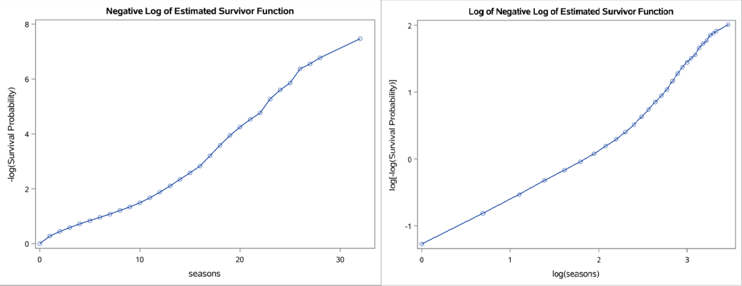
Overall Distribution: Other graphs
Both graphs show a steady, upward trend, indicating a consistently declining survival rate
Exponential function does not fit well: high curvature
Weibull fits well up to a point, further model exploration is required (ch 12)
Notes:
Both the -log(S(t)) and the log(-log(S(t))) graphs show a linear, upward trend, indicating a consistently declining survival rate
Survival time never stabilizes, players are always at risk of being thrown out

Slide 12
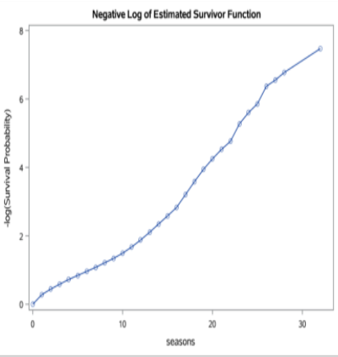
Overall Distribution: Product limit hazard function
-ln(S(t)) also approximates cumulative hazard
The hazard increases steadily and never stabilizes
Notes:
The Cumulative hazard is increasing at a consistent rate, implying that players are always at risk of being dropped from the league

Slide 13
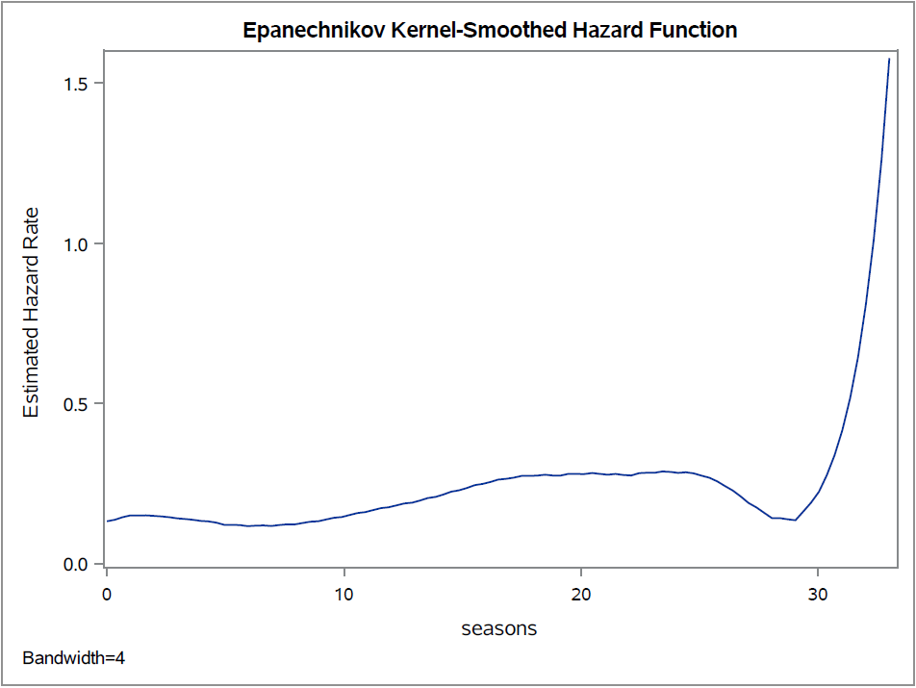
Overall Distribution: Kernel-Smoothed Hazard functions
We chose 4 for the bandwidth: the median
Epanechnikov kernel gave the best compromise between accuracy and smoothness
Hazard starts high and never stabilizes
Notes:
The E-Kernel graph shows that the hazard starts off reasonably high and steadily increases the longer a player is in the league

Slide 14
Overall Distribution: Summary
All previous graphs support the idea that the NBA is extremely competitive
Most players are out by the end of their 4th season
The rate of losses never stabilizes
The Hazard rate starts high and only goes higher
In conclusion: being an NBA player is hard

Slide 15
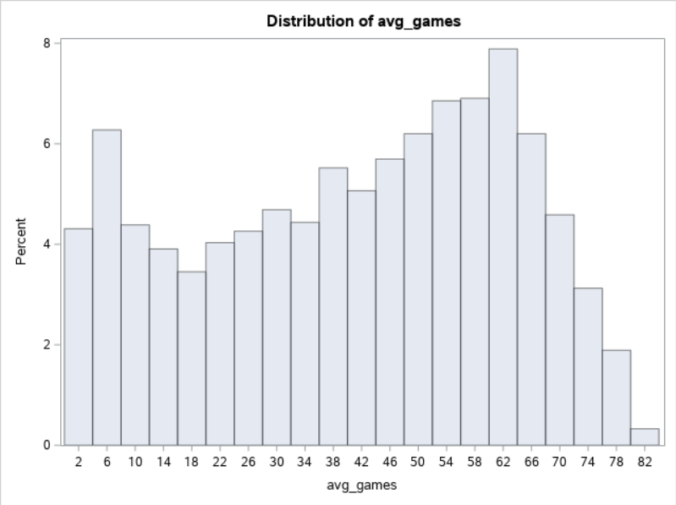
Covariate 1: Average games played
We split average games per player into three categories based on percentile, grouping the last two quartiles together due to the slight left-skew of the data
Low: 0 - 22.5
Size: 885
Medium: 22.5 - 43.5714
Size: 925
High: 43.5714 -
Size: 1697

Slide 16
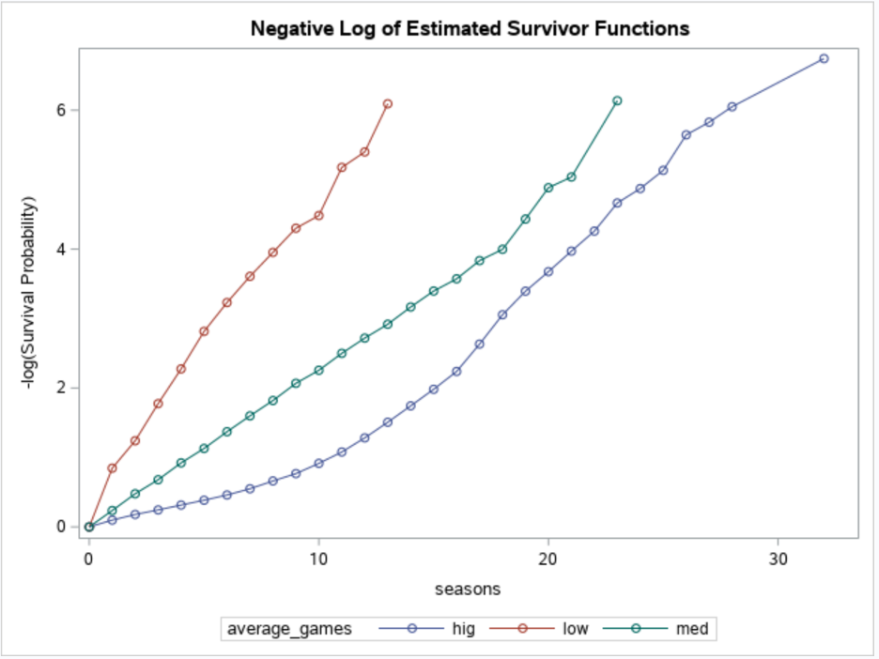
Average games played: Product-Limit Hazard
At 10 Seasons
Low: Hazard = 4 (-log(S(t))
Medium: Hazard = 2
High: Hazard = 1
Obvious trend of those with more games having less risk of being cast from the league

Slide 17
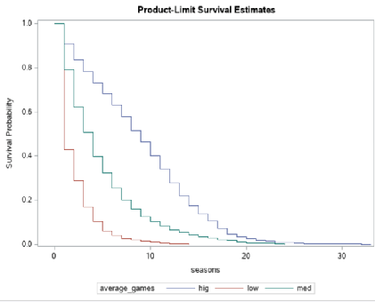
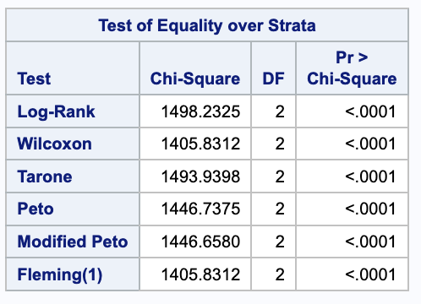
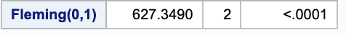
All 7 tests agree, average games makes a difference
Medians:
Low: 1 Season
Med: 4 Seasons
High: 9 Seasons
By 5 Seasons:
Low: 5%
Med: 30%
High: 70%
Average games played: KM

Slide 18
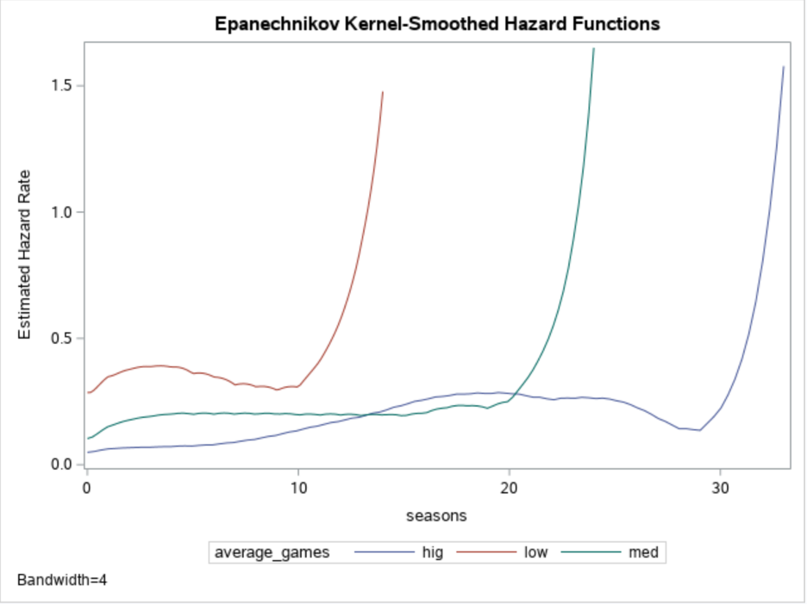
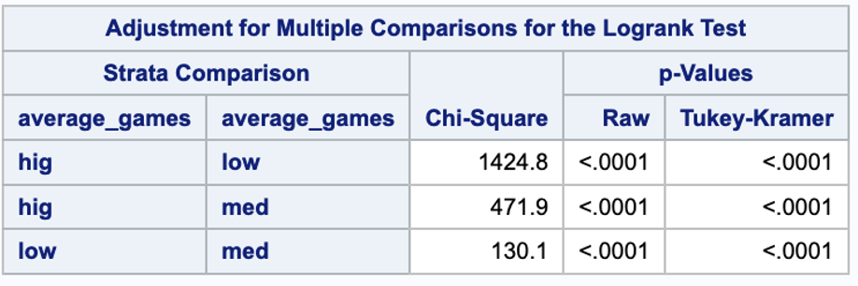
Average games played: Hazard
All subgroups are different
Hazard raises drastically after a point, which depends on average number of games

Slide 19
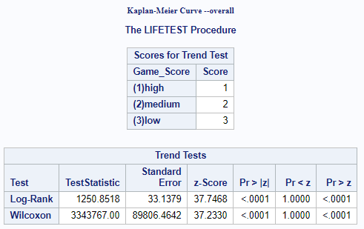
Average games played: Trend
One-way trend is incontrovertible: more games played on average leads to longer career

Slide 20
Average games played: Summary
All data points to the presence of a trend
A higher number of average games played will make a player a much greater asset to the team.

Slide 21
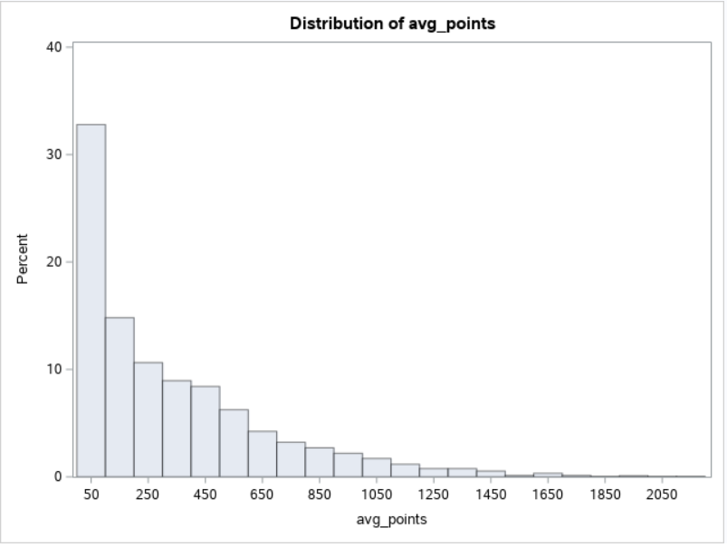
Covariate 2: Average Points
Heavy right-skew, we decided to create two groups that captured the top 10% of the distribution, since the players who are in this group might be highly-significant
Levels Ranges:
95 to 100% 1041.455 <
90 to 95% 817.231 to 1041.455
75 to 90% 492 to 817.231
50 to 75% 222.688 to 492.667
25 to 50% 62 to 222.688
0 to 25% 0 to 62

Slide 22
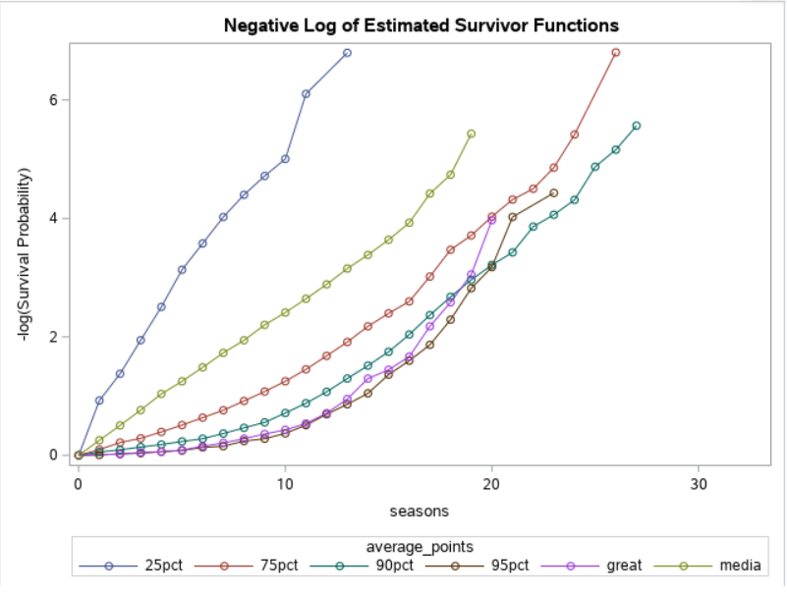
Average points played: Product-Limit
A higher percentage leads to a lower hazard rate in ⅚ cases
The top 5% (great) is exiting the league at a higher rate than two groups with fewer points

Slide 23
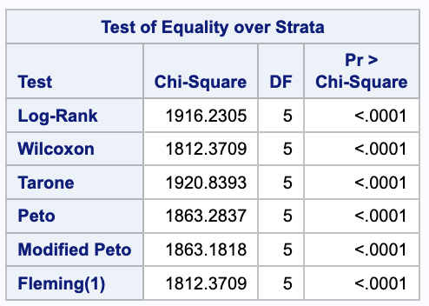
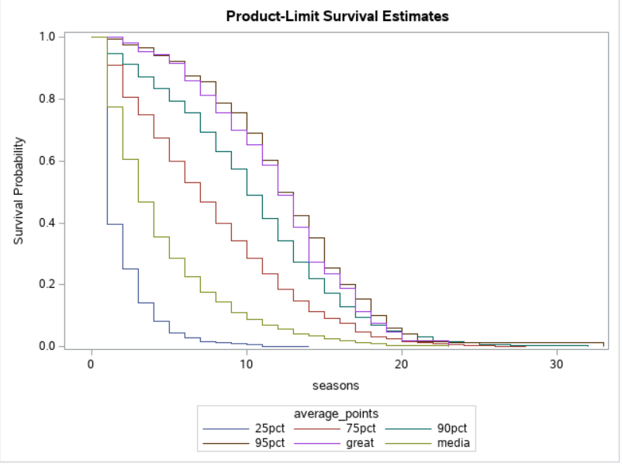
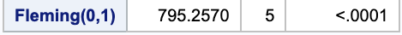
Average Points: KM Curve
Average points make a difference by all 7 tests
Median:
0-25%: 1 season
25%-50%: 3 seasons
50%-75%: 6 seasons
75%-90%: 10 seasons
90%-95%: 13 seasons
95%- : 12 seasons

Slide 24
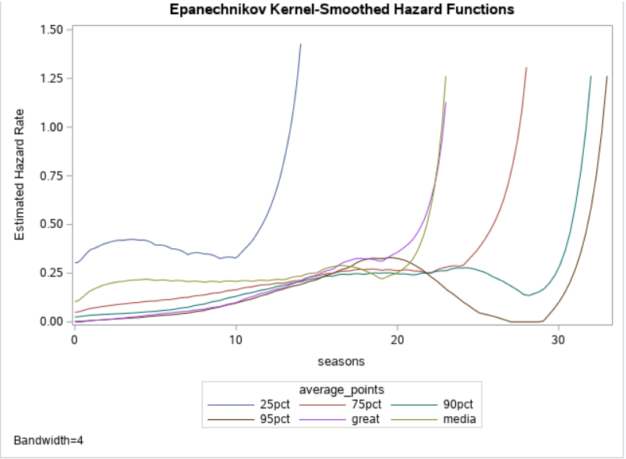
Average Points: Kernel-Smoothed Hazard
Most groups follow a clear progression of more points leads to less hazard
However, the top 5%(great) seem to exit the league sooner than those with fewer points

Slide 25
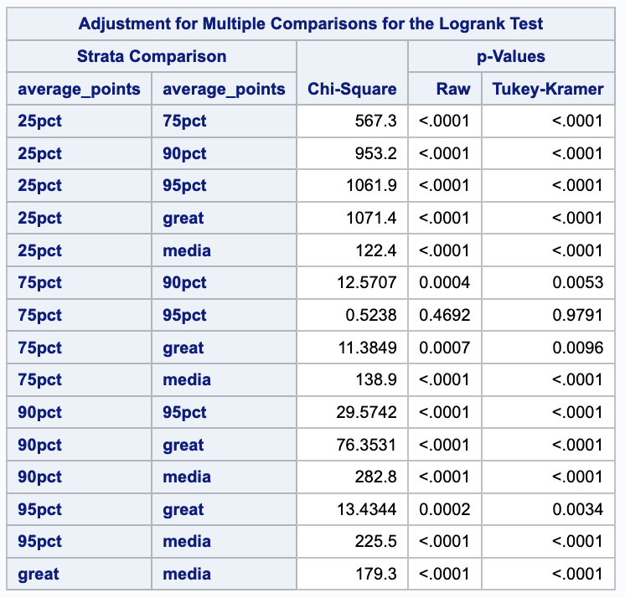
Average Points: Pairwise Comparison
Most groups are significantly different
50-75% vs 90-95% are not significantly different
Perhaps those with the high numbers of points leave for some reason other than being thrown out

Slide 26
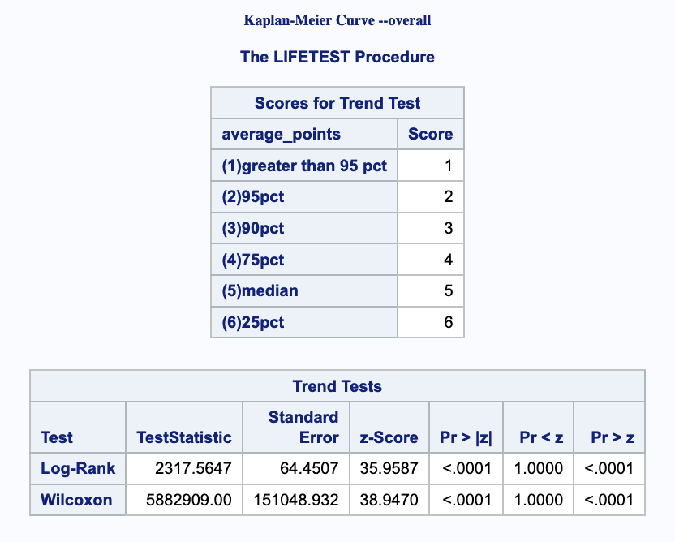
Average Points - Trend
Trend evident: Having more points does help to a degree

Slide 27
Average Points - Summary
Evidence is overwhelming that having more points on average will help a player to stay in the league longer
However, the absolute best players seem to leave the league sooner than they have to
It is fair to assume that many of the best players are paid better, worked more, and choose to retire early: like Michael Jordan

Slide 28
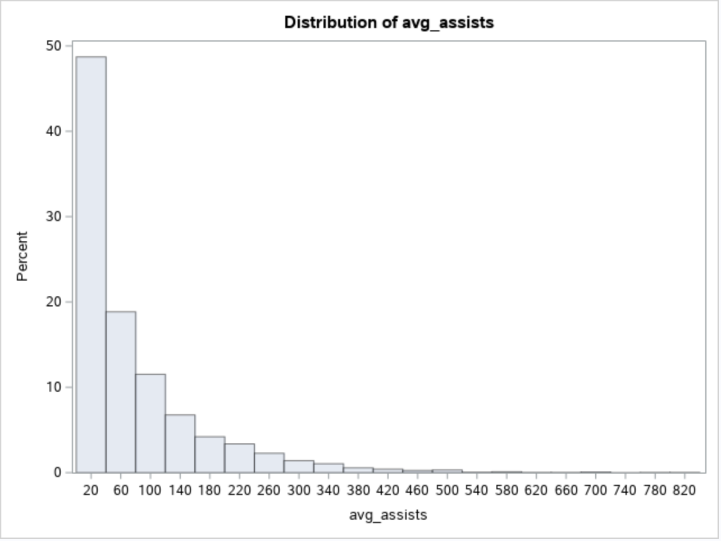
Covariate 3: Assists
Assists Levels Cutoffs:
95 to 100% 264.667 -
90 to 95% 199.091 to 264.667
75 to 90% 104.273 to 199.091
50 to 75% 42 to 104.273
25 to 50% 11 to 42.000
0 to 25% 0 to 11.000
Average assists were split up very similarly to how we divided Average points

Slide 29
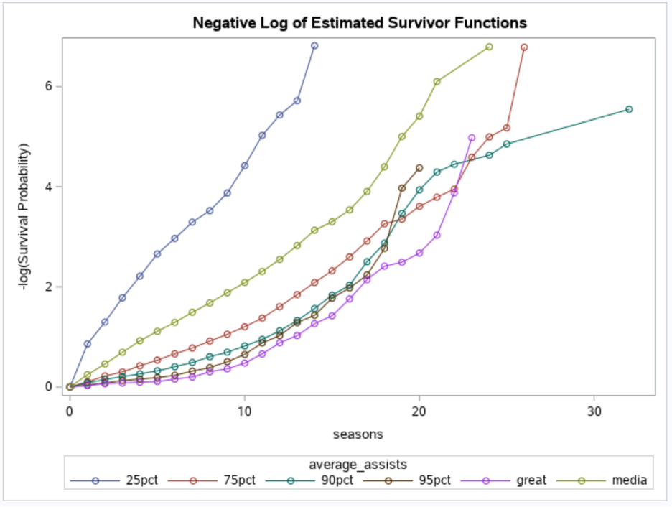
Assists: Product-Limit
More assists on average consistently leads to lower hazard
Those with less than 25% assists exit the league at twice the rate of anyone else

Slide 30
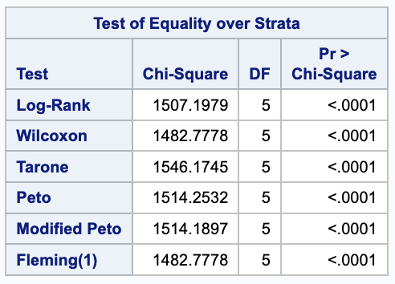
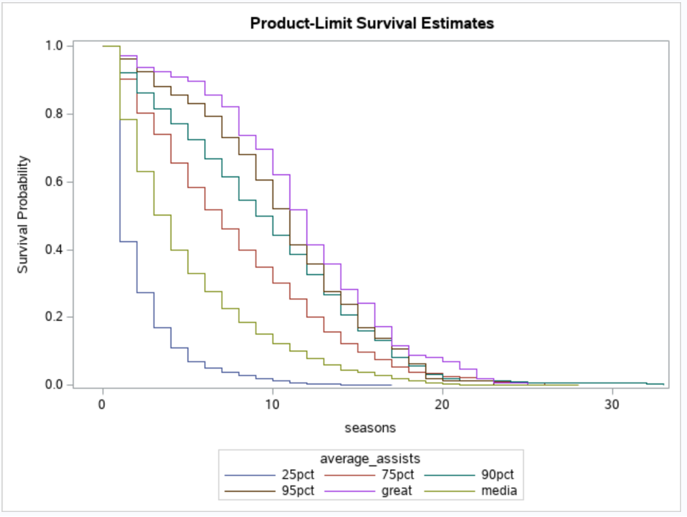
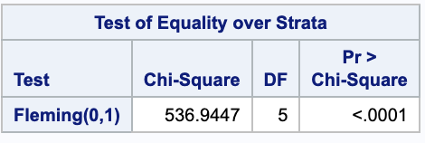
Assists: KM curve
Average assists make a difference by all 7 tests
Medians:
25pct - 1 season
50pct - 4 seasons
75pct - 7 seasons
90pct - 9.5 seasons
95pct - 11 seasons
>95pct - 12 seasons

Slide 31
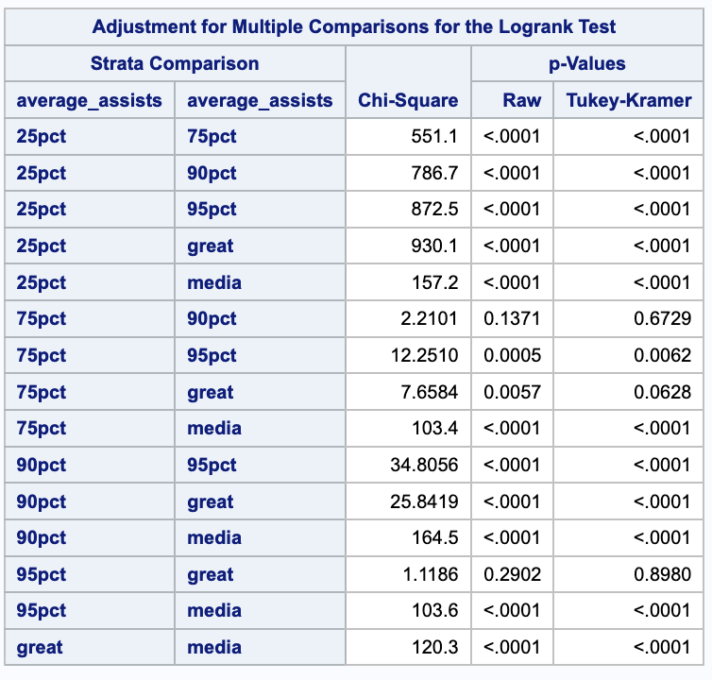
Assists: Pairwise Comparison
50-75% vs 75-90% and 90-95% vs 95-100% are not significantly different
High assist rates may only be helpful up to a point
In a future study, we would use fewer levels

Slide 32
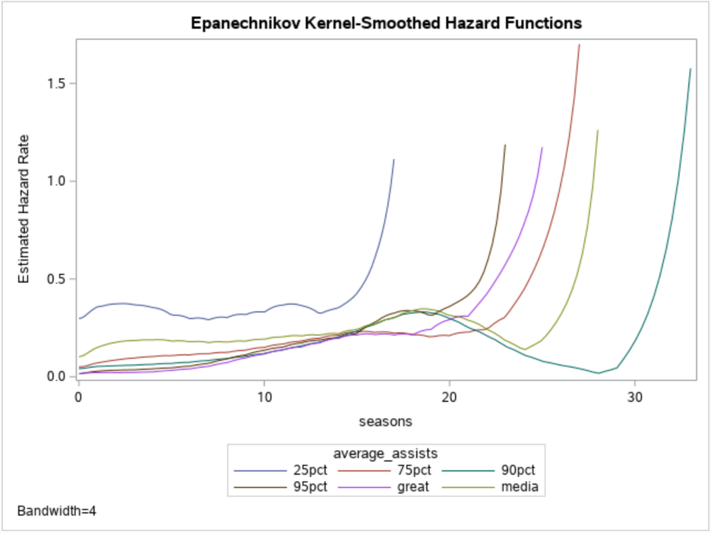
Kernel-Smoothed Hazard
Hazard does not indicate clear ordinal progression
Those in the top ten percent seem to have low hazard up to a point, then exit the league sooner than those with fewer assists

Slide 33
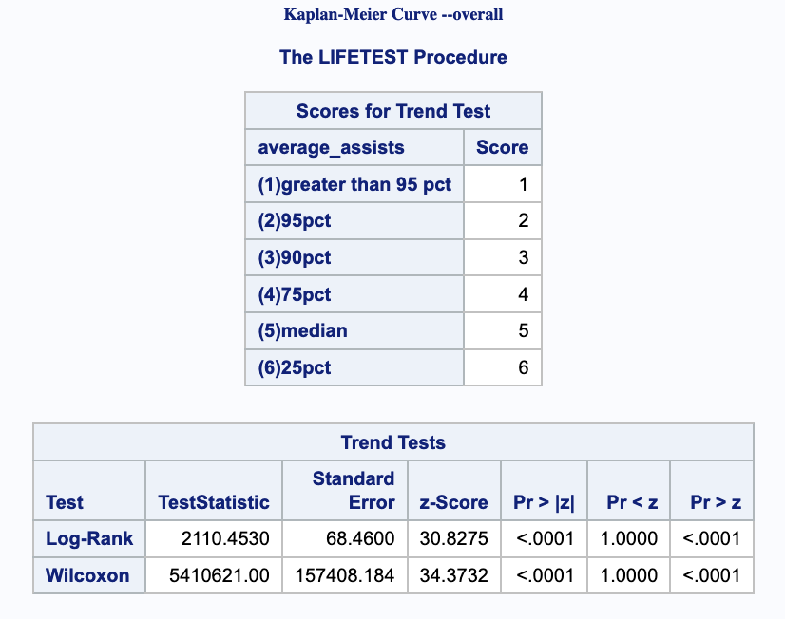
Assists: Trend
Upward trend apparent: more assists lead to a longer career on average

Slide 34
Assists: Summary
The trend is clear, a high rate of assists will help players stay in the league longer
However, the data also indicates that having too high a rate of assists may actually result in a player leaving the league sooner
For a player to truly be seen as one of the best, they cannot rely too heavily on scores through assists and must score on their own

Slide 35
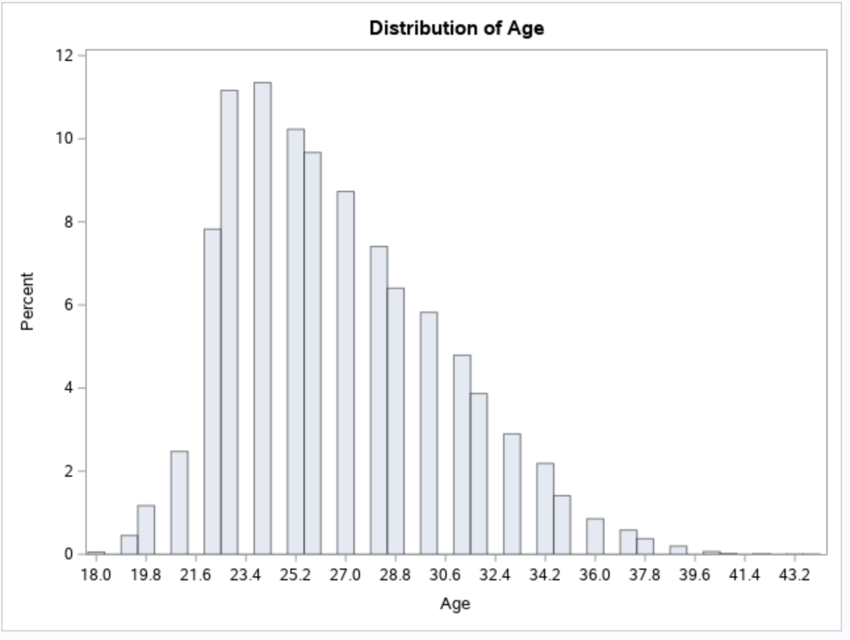
Covariate 4: Starting Age
We split stating age into three groups to see if it had an effect on the length of the player’s career
Start Age Levels:
Younger than 24
24-27
Older than 27

Slide 36
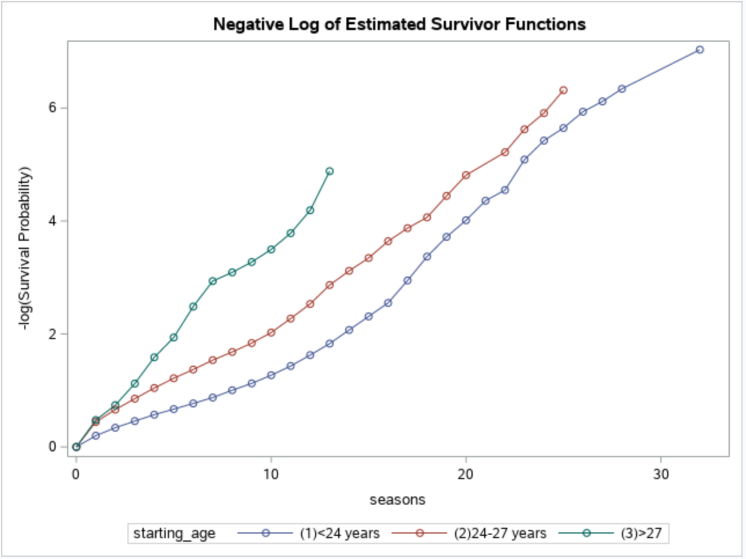
Starting Age : Product-Limit
At 10 Seasons
<24: Hazard = 1
24-27: Hazard = 2
27<: Hazard = 3
Younger players have less risk of being cast from the league

Slide 37
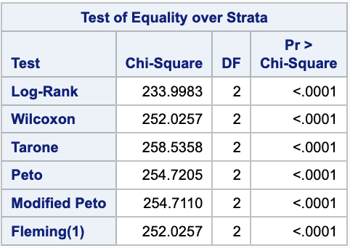
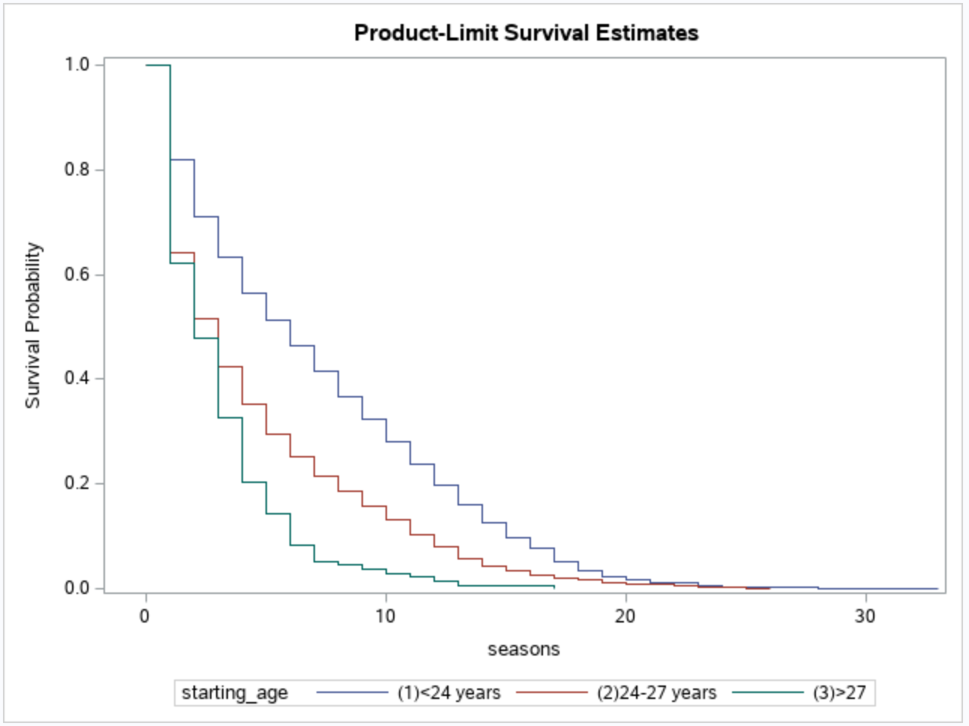
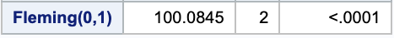
Starting Age: KM curve
All 7 tests agree, age matters
Medians:
<24: 5 Seasons
24-27: 2 Seasons
27<: 2 Seasons
By 5 Seasons:
<24: 50%
24-27: 30%
27<: 10%

Slide 38
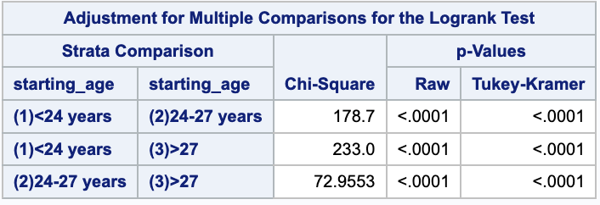
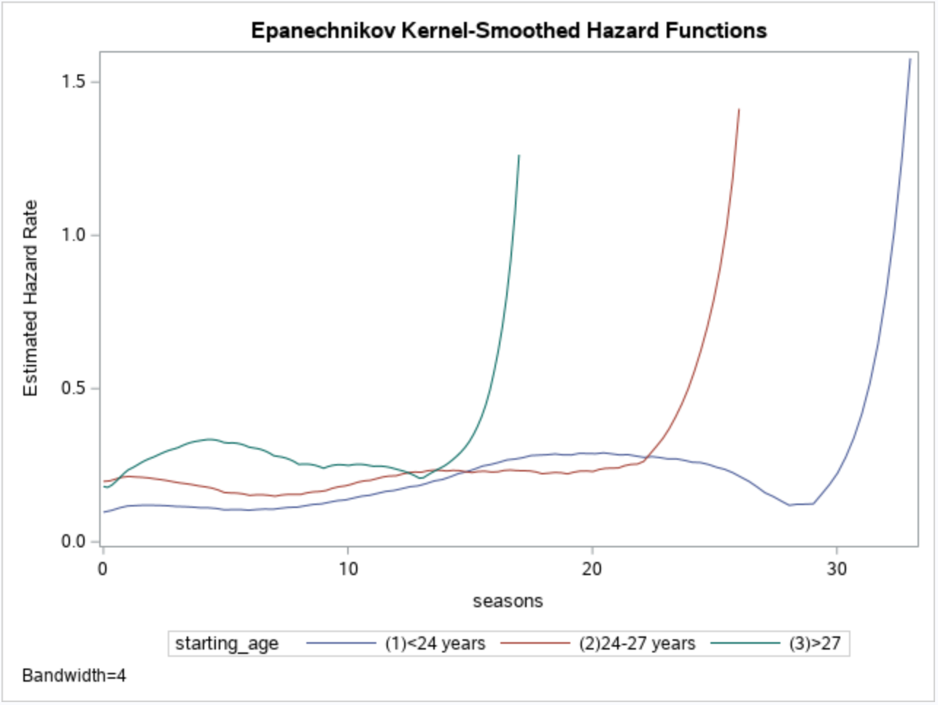
Starting Age: Kernel-Smoothed Hazard
All age subgroups are different
Hazard is higher and raises drastically after a point, for older players

Slide 39
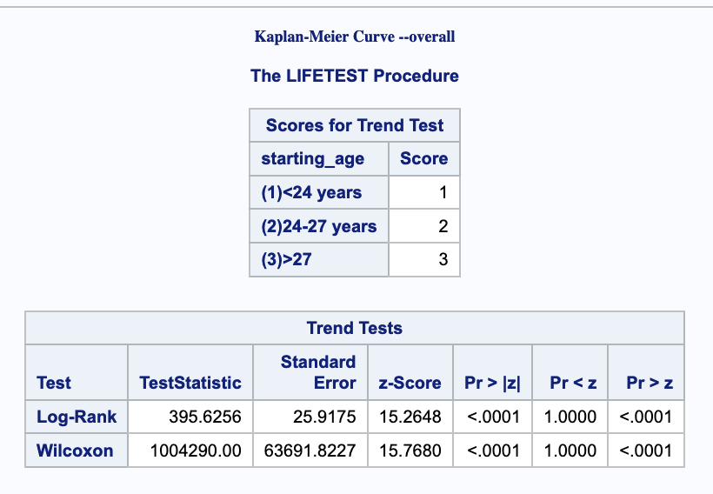
Starting Age: Trend
Obvious downward trend based on increasing age

Slide 40
Starting Age: Summary
.Players who join the league younger have a better chance to last longer
Coaches are more likely to invest in them given how many years they could play
If you want to join the NBA, start soon!

Slide 41
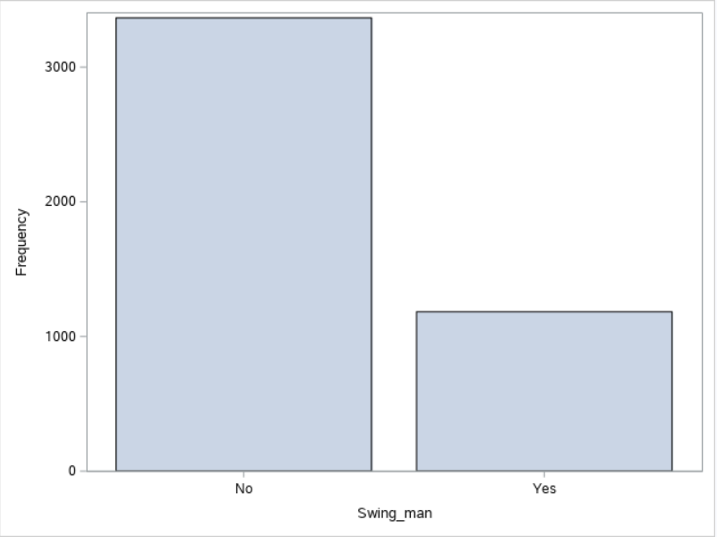
Covariate 5: Swing Man
Swing Man variable based on whether or not a player has switched positions at least once in their career.
Around two-thirds of all players have not switched positions at all their whole career, one-third have

Slide 42
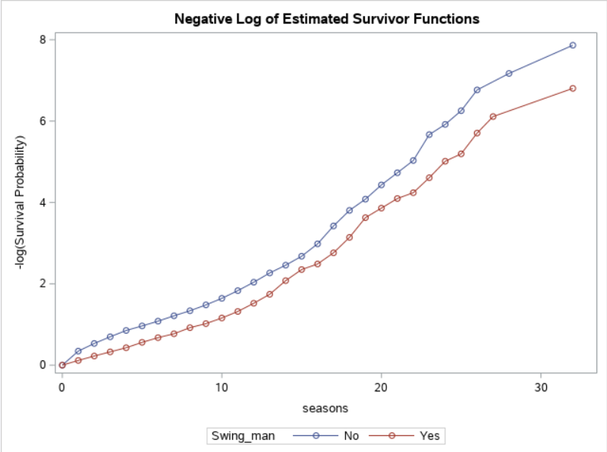
Swing Man: Product-Limit Estimates
The rate of hazard is similar, but noticeably-different
Those who changed positions are doing better at every point

Slide 43
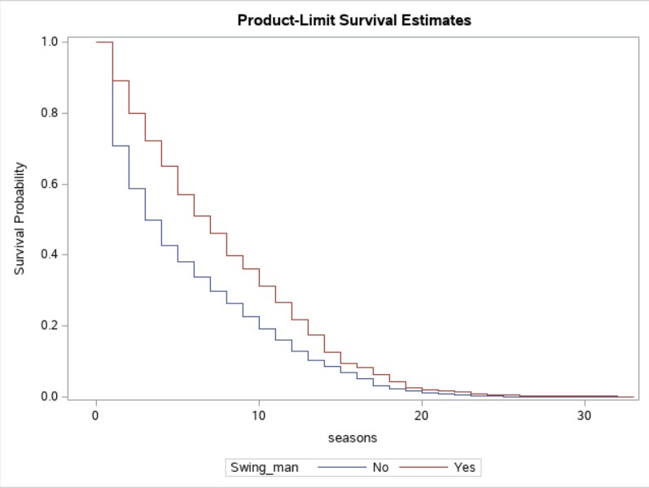
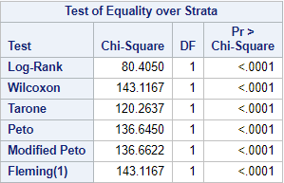
Swing Man: KM Curve
The two levels are different by all 7 tests
Medians:
No: 3 seasons
Yes: 6 seasons
5 Seasons:
No: 40 %
Yes: 60%

Slide 44
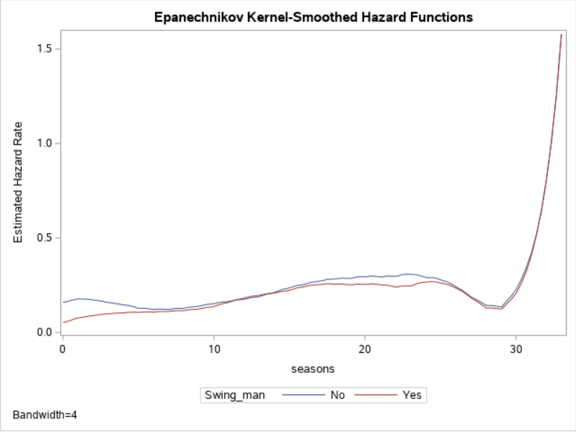
Swing Man: Kernel-Smoothed Hazard
The rates are very similar, but those who haven’t changed positions are almost always doing worse

Slide 45
Swing man: Summary
Players who have changed positions are clearly more likely to have longer careers than those who haven’t
A player who can play multiple positions will be seen as a greater asset to the team

Slide 46
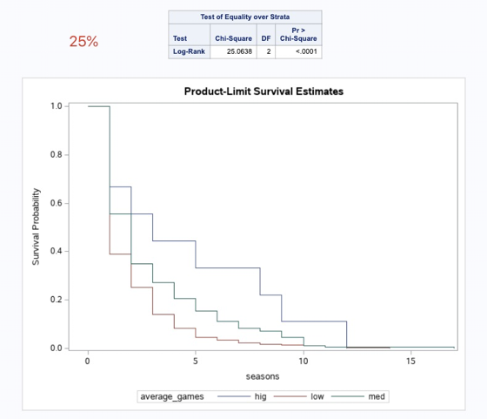
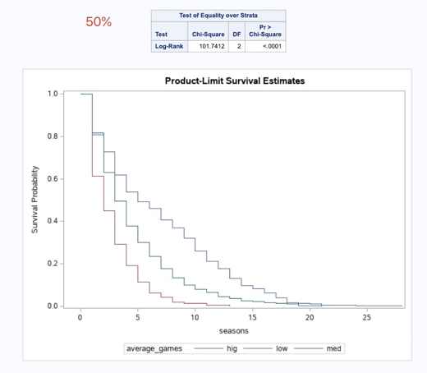
Interaction 1:
Average_assists*average_games
Notes:
Quantiles for assists column
95% 264.667
90% 199.091
75% Q3 104.273
50% Median 42.000
25% Q1 11.000
Low: 0 - 22.5000
Medium: 22.5 - 43.5714
High: 43.5714 -
Let’s talk interactions,

Slide 47
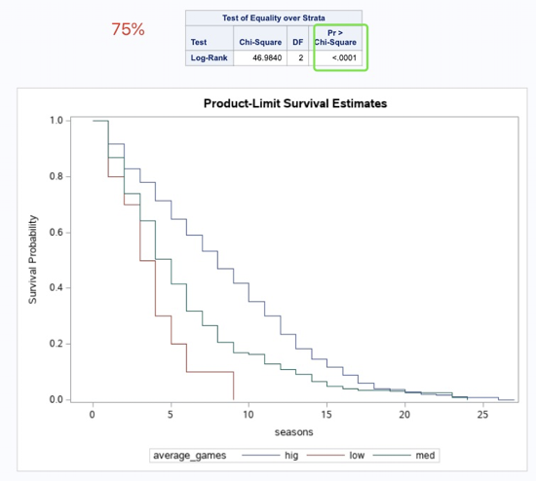
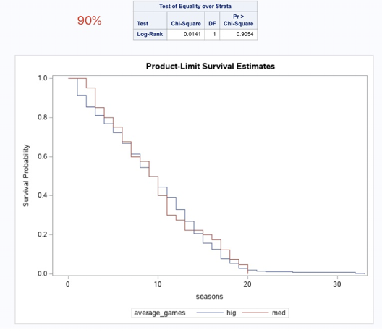
Interaction 1(cont.):
Average_assists*average_games
Notes:
From 25% to 90%, we can find, for average_games, low, medium, high, their survival probability distribution change a lot. So we can conclude that, average_assits and average_games has a significant interaction

Slide 48
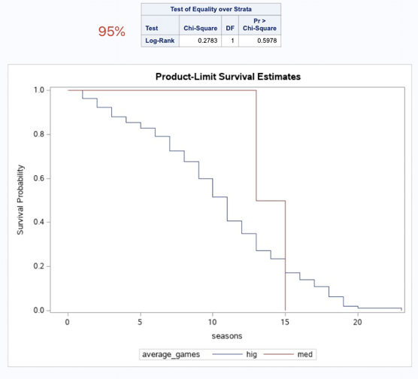
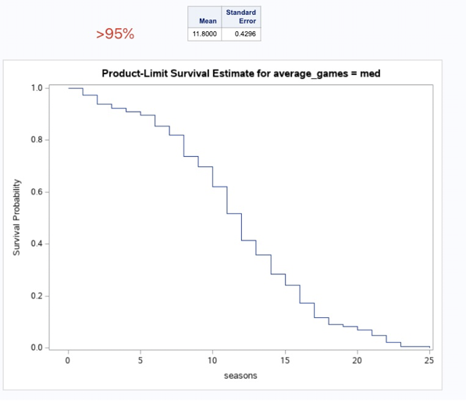
Interaction 1(cont.):
Average_assists*average_games

Slide 49
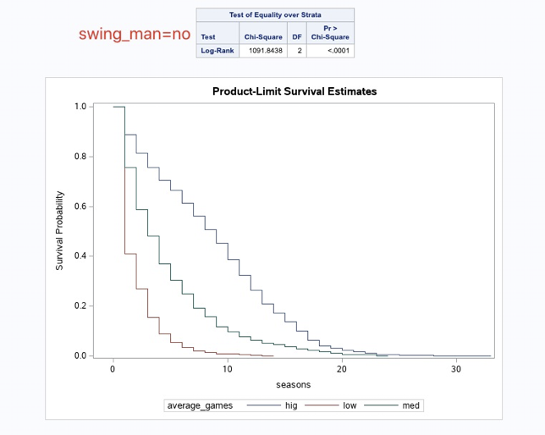

Interaction 2:
Swing_man*average_games
Notes:
average number of games levels:
0 to 24% 0 - 22.5000
25 to 49% 22.5 - 43.5714
Not significant
50 to 74% 43.5714 - 59.4211
75 to 100% 59.4211 and up
50 and 75 has been combined

Slide 50
Conclusion: Covariates
All Covariates are significant
Players who play more games, score more points, join the league at a younger age, have more assists, and play multiple positions are seen as assets to the team, and will have longer careers in the NBA as a result, being less likely to be dropped or traded

Slide 51
Conclusion: Interactions
Significant:
Average assists * Average games,
Average assists * Average points,
Average points * Average games,
Starting age*Average games,
Starting age*Average points,
Starting age*Average assists.
Not significant:
Swingman * Average games
Swingman*Average points
Swingman*Average assists
Swingman*Starting age

Slide 52
Conclusion: Final Model
Y = average_games*c_1 +
Swingman*c_2 +
average_points*c_3 +
averge_assists*c_4 +
starting_age*c_5 +
average_games*average_points*c_13 +
average_games*average_assists*c_14+
average_assists*average_points*c_34+
starting age*average games*c51+
starting age*average points*c53 +
starting age*average assists*c54.

Slide 53
Q & A
Questions?

